Slide 1
Welcome

Slide 2
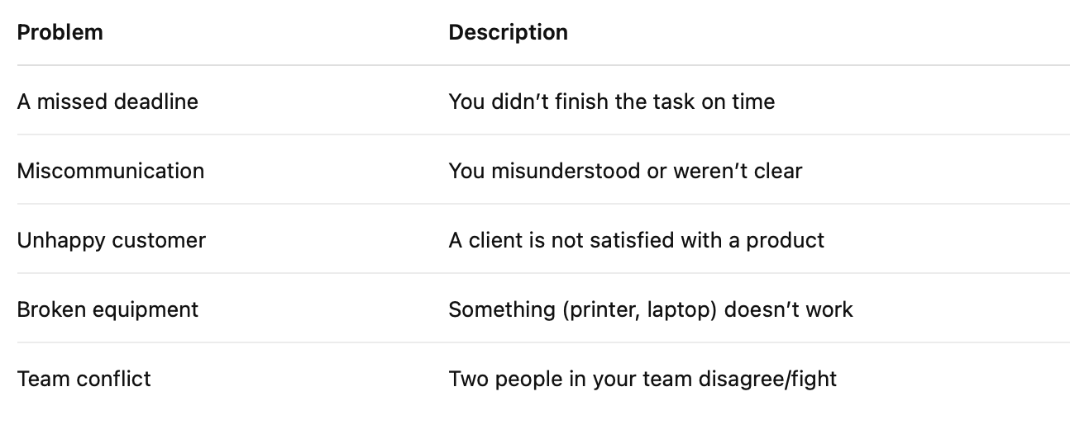
Explain the meaning of the problem in English

Slide 3
Discussion questions
• Have you ever had a problem at work? What happened?
• What are some common problems you have at work? How do you solve them?
• Who do you talk to when you have a problem at work?

Slide 4
Read the conversation and answer the comprehension questions
Luca: Hi Sara, do you have a minute?
Sara: Sure, Luca. What’s up?
Luca: The printer in the office isn’t working again. I tried to print the monthly report this morning, but nothing came out.
Sara: Oh no, not again. Didn’t we fix it last month?
Luca: Yes, but it keeps breaking. If we don’t replace it soon, we’ll keep missing deadlines.
Sara: You’re right. We can’t waste more time. You should send an email to IT right now.
Luca: OK, I’ll do that. But if they don’t respond quickly, what should we do?
Sara: If they don’t respond by tomorrow, I’ll talk to the manager and request a new printer.
Luca: Sounds good. Thanks, Sara!
Sara: No problem. Let me know what they say.
a) True or False?
1. Luca is happy because the printer works well. (T / F)
2. Luca couldn’t print an important report. (T / F)
3. Sara wants to wait before contacting IT. (T / F)
4. If IT doesn’t reply, Sara will talk to the manager. (T / F)
b) Short Answers
1. What’s the problem in the office?
2. What does Sara suggest doing first?
3. What will Sara do if IT doesn’t respond?
4. Why is the problem important?

Slide 5
Luca:
Hey Sara, do you have a minute? We’ve hit another snag this morning.
Sara:
Let me guess — the printer?
Luca:
Exactly. I tried printing the monthly reports, and it completely froze. I restarted it twice, but nothing worked.
Sara:
This is getting ridiculous. Didn’t IT say they fixed it last week?
Luca:
They did — or at least they said they did. But if this keeps happening, we’ll fall behind again.
Sara:
You’re right. We can’t afford another delay. I think you should escalate it and cc the office manager. Maybe we can finally get approval to replace the thing.
Luca:
Will do. And if they don’t respond by this afternoon?
Sara:
Let me know. If necessary, I’ll speak to the director myself.

Slide 6
1st conditional
If + present simple, will + verb
• If we don’t replace it soon, we’ll keep missing deadlines.
• You should send an email to IT.
• If they don’t respond by tomorrow, I’ll talk to the manager.
We can use should instead of will for advice.
We can also use may or might instead of will when we are less sure
I can change the clauses round, there is no difference in meaning. The only difference is when we write.
•I’ll talk to the manager if they don’t respond by tomorrow,

Slide 7
Complete the gaps with the correct form
If + present simple, will + verb
1. If we __________ (not fix) the printer, we __________ (miss) the deadline.
2. They __________ (come) and check it if Luca __________ (call) IT.
3. If the report __________ (not be) ready, the manager __________ (be) angry.
4. We __________ (talk) to the office manager if they __________ (not answer) by 3 p.m.
5. If you __________ (forget) your password again, you __________ (need) to reset it.
6. We __________ (miss) the meeting if the internet __________ (go) down during the call.
7. If Sara __________ (send) the wrong file, the client __________ (get) confused.
8. It __________ (arrive) by Friday if we __________ (order) a new printer today.
9. If I __________ (not finish) the slides, we __________ (not be) ready for the presentation.
10. Someone __________ (help) you if you __________ (ask) for support.

Slide 8
1. You arrive late to a meeting.
→ You should ____________________________.
→ Your manager ____________________________.
2. The team doesn’t understand the task.
→ You should ____________________________.
→ They ____________________________.
3. Your phone battery is always low.
→ You should ____________________________.
→ You ____________________________.
4. A colleague looks stressed.
→ You should ____________________________.
→ They ____________________________.
5. You forgot to save your presentation.
→ You should ____________________________.
→ Your work ____________________________.
6. The internet connection is unstable.
→ You should ____________________________.
→ The video call ____________________________.
7. You didn’t prepare for the meeting.
→ You should ____________________________.
→ You ____________________________.
8. You missed an important deadline.
→ You should ____________________________.
→ Your client ____________________________.
For the second sentence use will, might or may
You can also use the negative; won’t might not, may not.

Slide 9
Work problems
Student A: I forgot to send an important email to the client.
Student B: You should send it now and explain the delay.
If the client gets angry, your boss might talk to you.
1. The coffee machine is broken again.
2. You forgot to send an important email.
3. A customer is unhappy with your service.
4. You lost your key card and can’t enter the office.
5. Your computer is extremely slow today.
6. You’re feeling very stressed with deadlines.
7. A colleague didn’t show up for a team meeting.
8. You left your phone at home.
9. The internet isn’t working and you have a Zoom call.
10. You don’t understand the instructions from your boss.

Slide 10
Decide if the sentences are correct or incorrect
1. If we won’t leave now, we’ll miss the train.
2. If the internet goes down, we might lose the connection.
3. If she will call the client, he might change his mind.
4. If they don’t fix the printer, we’ll have a big problem.
5. You’ll finish the report faster if you ask for help.
6. If he doesn’t arrive soon, we miss the presentation.
7. If we will be late, the boss will be angry.
8. If the email doesn’t go through, I’ll resend it.
9. I might join the meeting if I will finish early.
10. If the manager sees this mistake, she may not be happy.

